Slide 1
Innovation Management Techniques
Prof. Koliya pulasinghe

Slide 2

Innovation Management Techniques
Innovation Management – Revisit
Innovation Management Techniques/Tools (IMT)
Knowledge Management
Intellectual Property Rights
Customer Relationship Management
Business Intelligence
Brainstorming
Mind mapping
Prototyping
Quality Function Deployment
Business Simulation

Slide 3

Innovation Management
Innovation is the process of making changes to something established by introducing something new that adds value to customers and contributes to the knowledge store of the organization.
Innovation management allows the organization to respond to external or internal opportunities, and use its creativity to introduce new ideas, processes or products.
Kelly, P.; Kranzburg M. (1978). Technological Innovation: A Critical Review of Current Knowledge. San Francisco: San Francisco Press.

Slide 4

Innovation Management Techniques/Tools
Innovation does not always mean using the very latest cutting-edge technology. On the contrary, it is less a question of technology and more a way of thinking and finding creative solutions within the company
IMTs can be seen as a range of tools, techniques and methodologies that help companies to adapt to circumstances and meet market challenges in a systematic way
Following IMT are well developed and standardized, aimed to improve the competitiveness of firms by focusing on knowledge, and in common knowledge

Slide 5
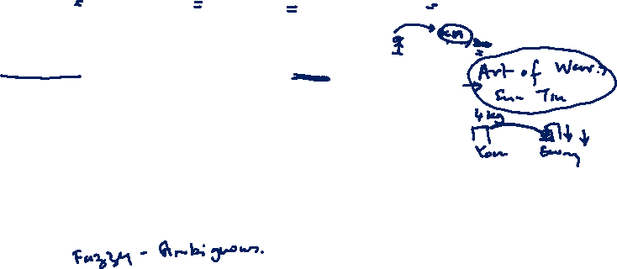
IMT – Knowledge Management
KM is the process of creating, sharing, using and managing the knowledge and information of an organization
Perspectives: Community of Practice, Intellectual Property
Dimensions: Tacit Knowledge and Explicit Knowledge
Strategies: Knowledge sharing (inter-project, inter/intra organizational), Storytelling, After action reviews/reflections, Knowledge mapping, CoP, Expert systems
Technologies: Groupware, Content Mgt/Document Mgt systems, eLearning systems

Slide 6

IMT – Intellectual Property Rights Mgt.
IPR is the potential source of market power: Managing existing IPRs and developing a culture to create new IPRs is important to an organization
Strategic use of IPR: Sell, License, Collaborate, Donate
Patent search/Technology search helps developing alternatives

Slide 7
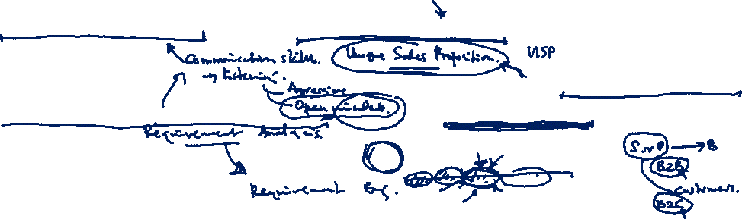
IMT – Customer Relationship Management
Gather, manage and use of Customer Information is imperative to sustain a business
Customer interviews focusing customer pain points are the core for product development
Social media and other technologies help businesses to connect with their customers and seeking their input during the idea generation of the product development lifecycle

Slide 8

IMT – Business Intelligence
BI technologies can handle large amounts of structured and unstructured data to help identify, develop, and otherwise create new strategic business opportunities
Technologies: Reporting, online analytical processing, analytics, data mining, process mining, complex event processing, business performance management, benchmarking, text mining, predictive analytics, and prescriptive analytics

Slide 9

IMT – Brainstorming
Brainstorming is a group creativity technique by which efforts are made to find a conclusion for a specific problem by gathering a list of ideas spontaneously contributed by its members
Rules: Go for quantity, withhold criticism, welcome wild ideas, combine and improve ideas
Normally followed by affinity grouping

Slide 10
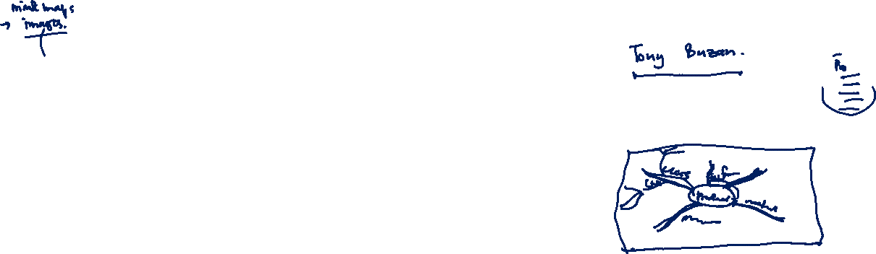
IMT – Mind Mapping
A Mind Map is a diagram for representing tasks, words, concepts, or items linked to and arranged around a central concept or subject using a non-linear graphical layout that allows the user to build an intuitive framework around a central concept
It is a visualizing technique similar to concept maps and modelling graphs

Slide 11

IMT – Prototyping
A prototype is an early sample, model, or release of a product built to test a concept or process
Prototyping serves to provide specifications for a real, working system rather than a theoretical one
Rapid prototyping is a group of techniques used to quickly fabricate a scale model of a physical part or assembly using three-dimensional computer aided design (CAD) data

Slide 12

IMT – Quality Function Deployment
Method to transform qualitative user demands into quantitative parameters, to deploy the functions forming quality, and to deploy methods for achieving the design quality into subsystems and component parts, and ultimately to specific elements of the manufacturing process
QFD is applied in product design, manufacturing, production, engineering, research and development (R&D), information technology, support, testing, regulatory, and other phases in hardware, software, service, and system organizations

Slide 13
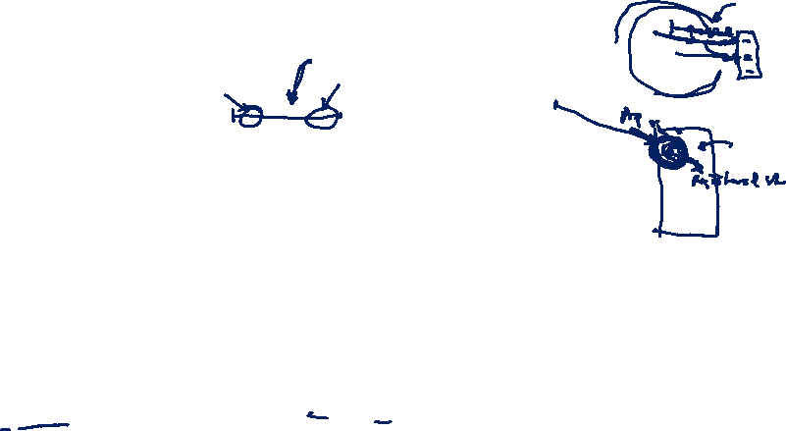
IMT – Business Simulation
Business simulation is simulation used for business training, education or analysis
Business process simulation is used to assess the dynamic behavior of processes over time, i.e. the development of process and resource performance in reaction to changes or fluctuations of certain environment or system parameters. The results provide insights on how improve factors such as process performance, process and product quality, customer satisfaction or resource utilization.
Marketing simulation games provide participants with an interactive method of testing out marketing decisions on marketing strategy, product positioning, pricing strategies, consumer behavior

Slide 14
Summary
Innovation Management – Revisit
Innovation Management Techniques/Tools (IMT)
Knowledge Management
Intellectual Property Rights
Customer Relationship Management
Business Intelligence
Brainstorming
Mind mapping
Prototyping
Quality Function Deployment
Business Simulation

